Slide 1
Usages of ICT
A user oriented innovation process
Sylvain Dejean - Coordinator

Slide 2
The Gis M@rsouin
Gathers Breton laboratories which have two common denominators
Human and Social Sciences expertises
The study of Internet « usages »
Is able to:
Lead research program
Evaluate public policy
Collaborate with industrial in a user oriented conception process

Slide 3
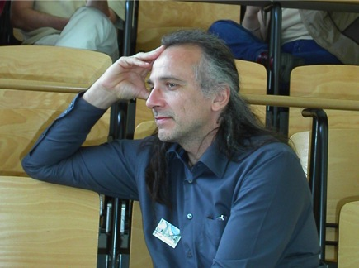
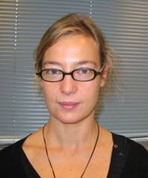
General organization
3 Platforms
TECHNOLOGICAL PLATFORM
OBSERVATORY
LABORATORY EXPERIMENT
to support
50 researchers in 4 universities and 2 schools
Economics Communication studies
Social Cognitive Psychology
Education science
Management Science, Political science
Ergonomy Sociology

Slide 4
4 main fields of research
Learning
How digital technologies change and contribute to news forms of learning.
Social interaction
New technologies enable to create new sociability, new sharing process, news information and knowledge production, news media.
Public area
How can new digital technologies help public policy makers and citizen.
Market
Economic impact of digital technologies, e-commerce development, network economics.

Slide 5
The strengths of M@rsouin
Interdisciplinary
Diversity of expertise, methodology and knowledge
M@rsouin is able to coordinate and integrate all these various approaches
Put users at the core process
Observation in real context
Specific situation experimented in laboratory
Target users as regard to issues and needs addressed.
Ability to bring expertise's at each stage of the conception process.

Slide 6
The observatory
Couples questionnaire and research issues to produce original and meaningful analysis.
Content:
Photography of equipment and usages, prospective analysis, need assessment, satisfaction analysis, profiling.
Methodology:
Building questionnaire, sampling, definition of quotas and representatively, monitoring the survey (recovering respondents)
Treatment:
cleaning database, statistical analysis (cross and frequency tab) specific treatment, multivariate analysis (typology, factorial analysis), econometrics.

Slide 7
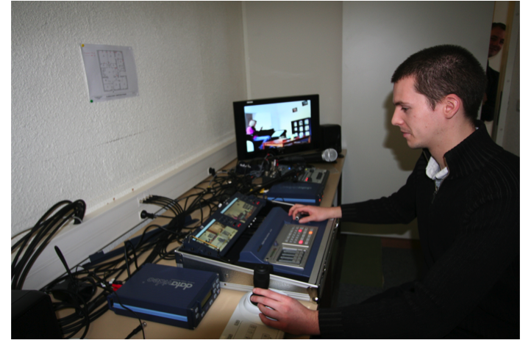
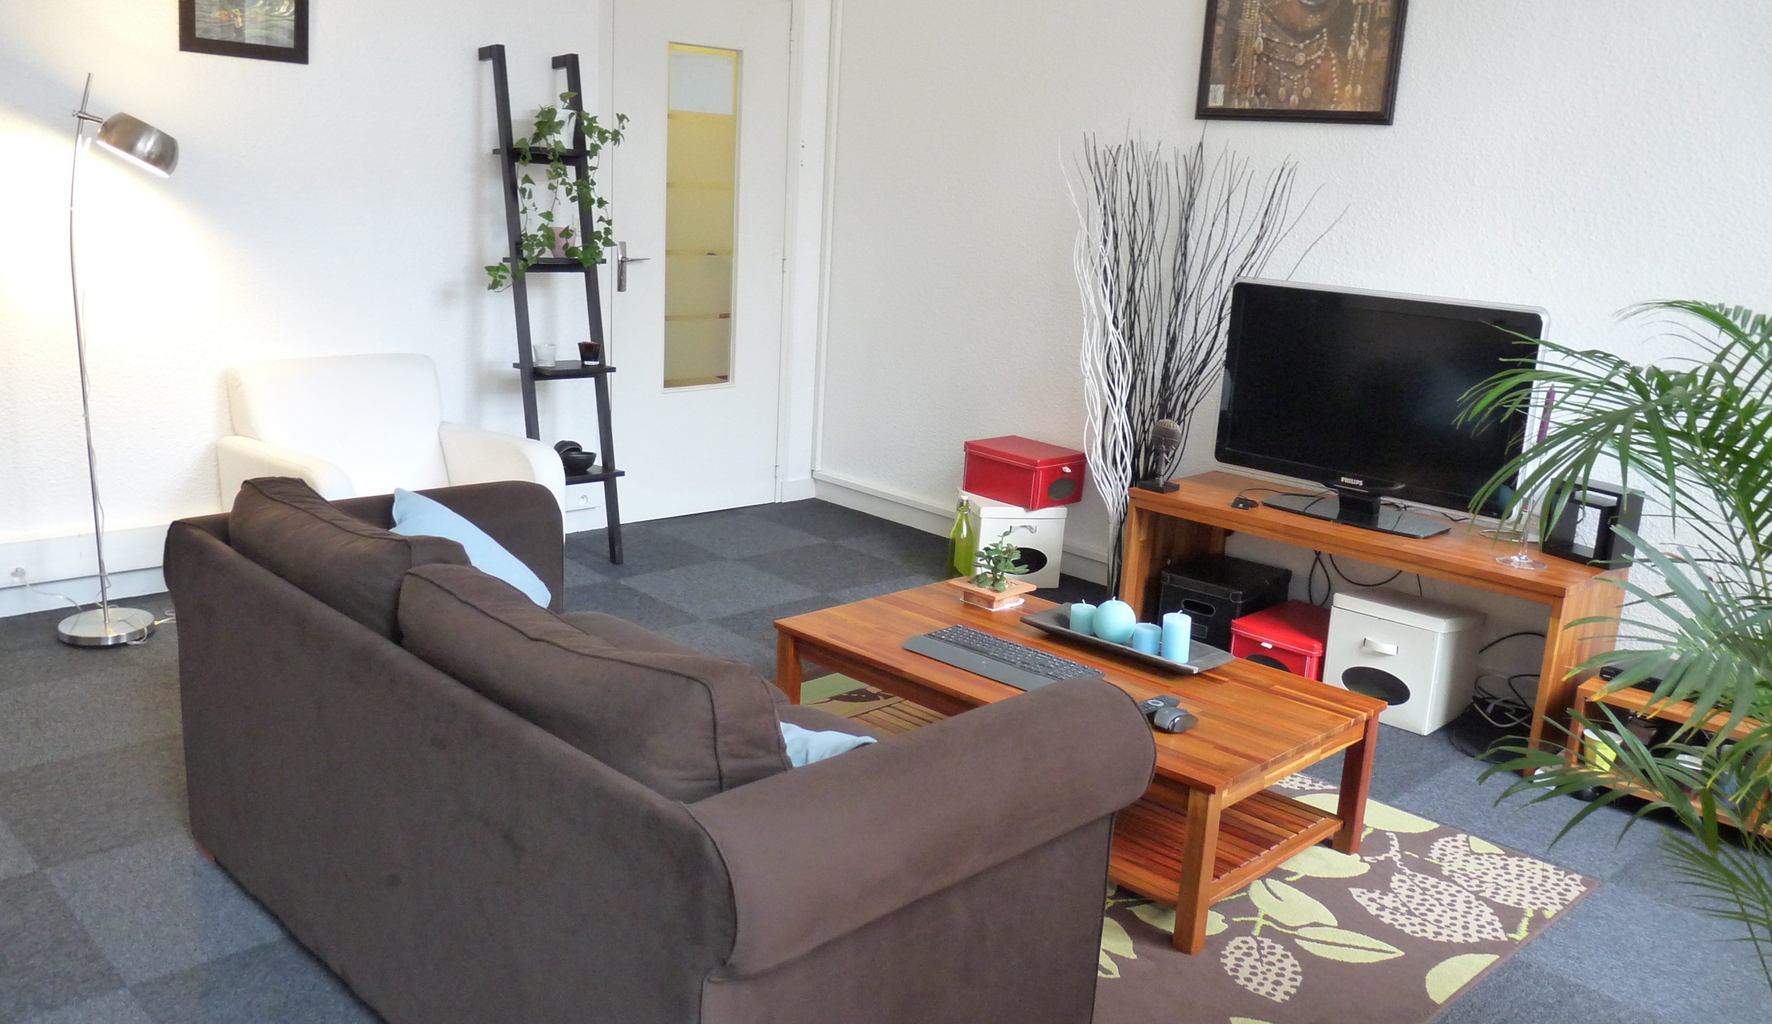
Laboratory experiment
A set of three platforms evaluating the uses of ICT
User-centered Design Process
Collecting and analyzing data on uses
Enhancing methods of observation
Usability testing and recommendations for product improvement.
Equipment :
Apartment
Audio-video recording
Eye-tracking and test room
Protocol to test:
Before design: user and organizational requirements analysis
During design: iterative design-evaluation
After design: acceptance evaluation, post experience interviews
LOUSTIC Rennes platform
Notes:
A set of three platform evaluating the uses of ICT
Human environment, ICT and the urban world in Rennes
Cooperative working and mobility in Brest-Lannion
Interfaces and mobility in Lorient-Vannes
POur information:
* inspections ergonomique est une méthode qui sollicite des ergonomes pour inspecter des interfaces ou des produits au regard de critères ergonomiques ( adéquation à des normes ou des recommandations )
Eye tracking est une technique utilisée dans les tests U ou les expérimentations pour évaluer les interfaces
* Tests U : sur un même panel de testeurs ( 10-12) qui testent une techno ou un produit selon un scénario / expérimentations : comparaisons expé sur groupes de testeurs qui voient deux types d’interface ( 15 dans gpe 1/ 15 dans gpe 2 )
Au cas où on te pose des questions
Acceptabilté des technologies
Acceptabilité
Acceptabilité sociale : perception qu’un individu possède des contraintes sociales impliquant l’utilisation d’une technologie donnée.
Acceptabilité individuelle : perception qu’un individu possède de la valeur d’un système et d’une technologie.
Deux déterminants de l’acceptabilité individuelle:
Utilité : degré auquel une personne croit que l’utilisation d’un système va améliorer ses performances
Utilisabilité : degré auquel une personne croit que l’utilisation d’un système ne lui demandera pas ou peu d’efforts.
Ces déterminants influencent indirectement les usages par :
Attitude d’usage
Intentions d’usage

Slide 8
Technological platform
ImaginLab is an open platform dedicated to integration test, interoperability and usages experiment of new digital technologies on fixed and mobile networks.
Lannion: Broadband connexion (FTTH, FTTO)
Brest: high speed wireless technology (LTE/4G)
Rennes: Digital TV (DVB-T2)
On each platform a panel of users “Imagineurs” are available to experiment, test and observe innovative services and products.

Slide 9
The user driven Innovation
Making products and services “usable”
Closing the gap between what user wants and what products are able to do.
Social and Human sciences are best able to bring their expertise.
Necessity to intervene early in the production process
A large, diverse and motivated panel of experimenter is needed.

Slide 10
How it works

Slide 11
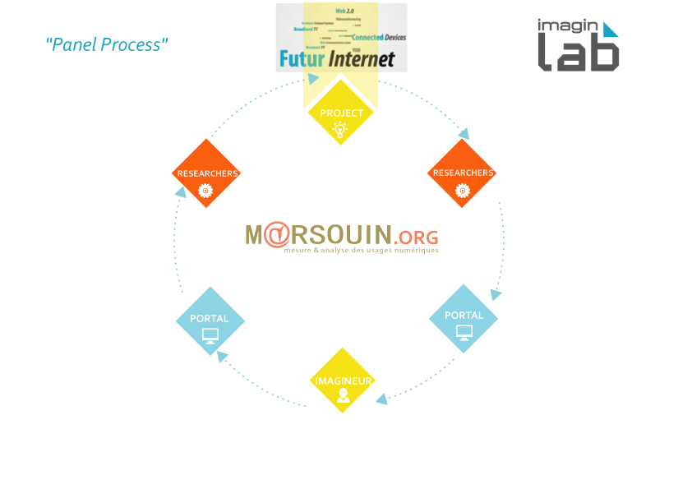
How it works

Slide 12
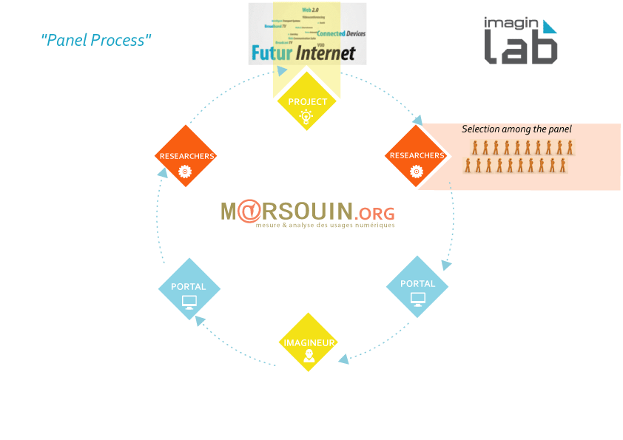
How it works

Slide 13
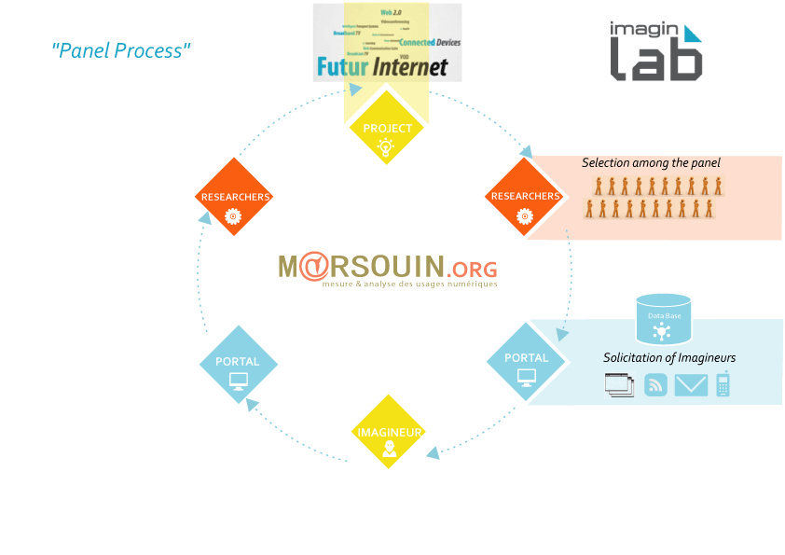
How it works

Slide 14
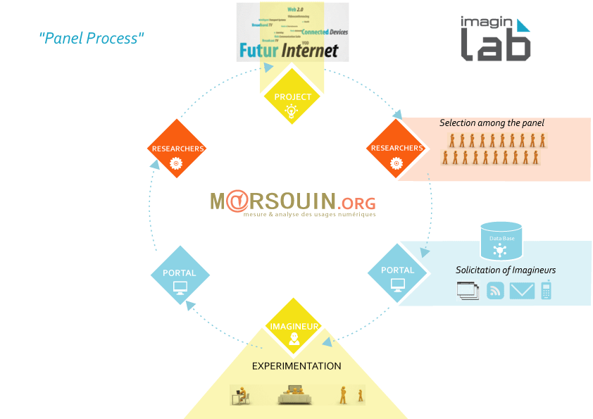
How it works

Slide 15
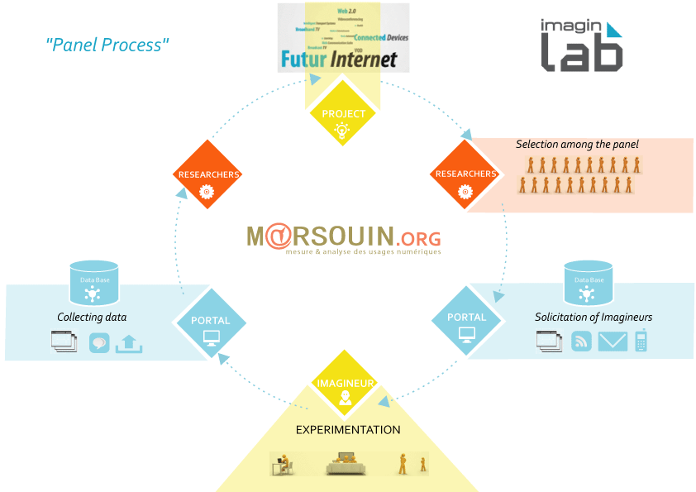
How it works

Slide 16
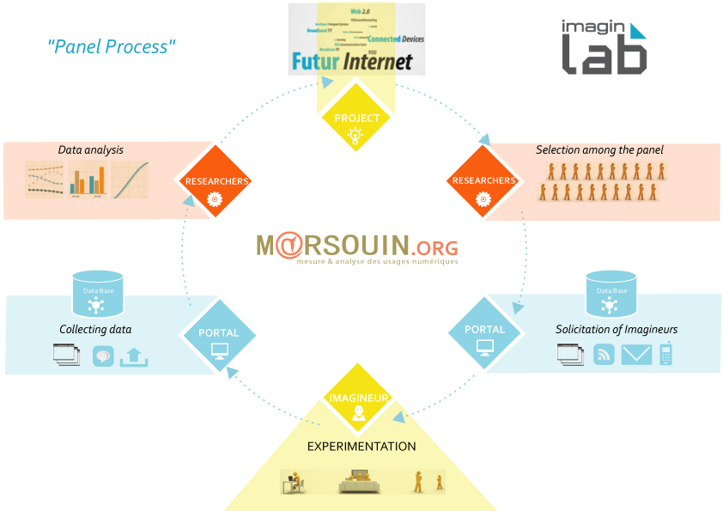
How it works

Slide 17
A user oriented conception process
Production process
Before
During
After
Users needs
Prototypes testing
Post-experience evaluation
Market analysis
Expert evaluation
Evolution of uses
Typology of current users and usages
Usability tests
Valuable
functionalities
Consumer fulfillment
Experiments
Observation in situ
Notes:
Ici, j’ai enlevé acceptance assessment car on parle d’acceptation et non d’acceptabilité: du coup, l’acceptation vient après l’usage donc dans les retours d’usage

Slide 18
Before the production process
Need to know WHO is going to use the product/service
Socio-economic characteristic
Age, income, formation, location
Current environment
Equipment, usage related to the new product and service.
Need to evaluate WHAT they need ? and WHY do they need it ?
What is missing in current usages
Barriers to usage, social and individual impediments
In the user point of view what would be valuable for future.
Evaluation of the willingness to pay, valuable functionalities
A market study
Analyze how the market is structured
Competition, legal and financial context

Slide 19
Before the production process
Issues addressed | Methodologies | DELIVRABLES
Who is going to use | Questionnaire: Representative population Targeted population Immersion Ethnographic investigation | Typology of users Statistical analysis of socio economic determinant of usages. Description of current environment
Users needs | Questionnaire: Representative population Targeted population Expected features of the prototype Interview Face to face Focus Group | Report on users needs Limitation of current usages Social and personnal barriers Acceptability of the future prototype features/ Définition of uses case Refinement of the user interface design rules
Market analysis | Economic and marketing survey | Market survey and issues

Slide 20
During the production process
How the user perceives the product/service and its functionality
Is it perceived as useful for future user?
Is it perceived as easy to use for future user?
Does the user intend to use the product/service?
User oriented conception
Iterative test between user and designer
Expert evaluations
Usability tests
Experiments
Aiming to record
Objective data ( errors, efficiency, eye tracking data, trace data)
Subjective data (satisfaction, usability, utility)
Until a final validation of the product/service
Notes:
Comparison of different scenari

Slide 21
During the production process
Issues addressed | Methodologies | DELIVRABLES
Enhancing utility and usability | Expert evaluation Few experts (user experience designer, software developer) inspecting the prototype according to a set of ergonomic rules for conception Usability test Few users (10-20) interacting with the prototype according to different scenarii Assisted observation: Eyetracking, audiovisual recording, trace analysis Experiments Experimental comparisons of prototype design with users (15/15) interacting with several versions of the same prototype according to different scenarii Assisted observation: Eye-tracking, audiovisual recording, trace analysis | Appropriateness to ergonomic rules Report on the perceived utility and usability of the service/product Report on usability performance and satisfaction. Report pointing the best prototype design Refinement of the user interface design rules

Slide 22
After the production Process
Consumer fulfillment
How the final product fit with user’s expectation
Evolution of uses
How does the user appropriated the service/product
Is there an evolution in the way he uses it
Issues addressed | Methodologies | DELIVRABLES
Consumer fulfillment & Evolution of uses | Questionnaire: Targeted population of users Acceptance of the product/service Interview Face to face | Report on real usage Post experience user acceptance (after using the product/service) Daily constraints and incitations to use the product/service Support requirements Recommendations for future development

Slide 23
Thanks for your attention
contact@marsouin.org
enquete@marsouin.org
eric.jamet@mshb.fr
severine.erhel@mshb.fr

